Slide 1
Advanced Approximation Algorithms II
How to find a heavy weight cut in a graph

Slide 2
The MAX CUT Problem
Given an undirected graph G=(V,E) with edge weights w:E->R, divide the vertices in two parts so that the sum of the weights of all edges going from one part to the other, is maximized.

Slide 3
The MAX CUT Problem
5
8
8
11
3
9
12
1
11
5
7
2
13
9
4

Slide 4
MAX CUT vs. MIN CUT
MIN CUT is polynomial time solvable (cf. Max flow algorithms, and Karger’s algorithm)
MAX CUT is NP-hard, even when the edge weights are the same, and no vertex has more than three neighbors.
Note that MAX CUT is trivial on bipartite graphs.

Slide 5
Overview
We will see two polynomial time techniques to obtain an approximative solution to the MAX CUT problem with a provable worst case approximation ratio.
Approximation based on local search refinement.
Approximation based on relaxation to semi-definite programming.

Slide 6
Local Search
Single flip neighborhood: As long as there exists a vertex that will increase the cut weight if it is put in the other part, move it.

Slide 7
Local Search
5
8
8
11
3
9
12
1
11
5
7
2
13
9
4

Slide 8
Analysis
The optimum can not be more than the sum of all weights.
In the approximation found, each vertex adds at least half of its neighborhood’s weight to the solution.
We get approximation ratio
apx/opt>= 0.5

Slide 9
Run Time Analysis?
There is no guarantee the number of flips, and hence the algorithm run time, is polynomially bounded!
Trick: Only flip if net gain is >= 2ε w(A,B)/n
We get 0.5-ε approximation.
Each flip improve the weight at least a factor (1+ε/n). After n/ε flips we have at least doubled the weight.
We need at most log2(OPT) doublings…

Slide 10
Mathematical Programing
Formulate your problem as an integer program (IP).
Provide a relaxation of the IP to a linear program (LP) or semidefinite program (SDP), i.e. something we know how to solve efficiently.
Round the fractional solution to the LP or SDP to an integer solution approximating the original IP

Slide 11
How to Obtain an Approximation Guarantee
OPT(SDP)
Bound on
Approximation factor
OPT(IP)
Actual approximation factor
OPT(SDP)_{Rounded}

Slide 12
Integer Programming
Introduce one {-1,1} variable x_{i} for each vertex i in V.
Solve for an assignment to the variables that maximizes

Slide 13
2D Relaxation
Introduce one 2-dimensional real vector of unit length variable y_{i} for each vertex i in V.
Solve for an assignment to the variables that maximizes

Slide 14
2D Relaxation Can’t be Worse

Slide 15
Randomized Rounding of 2D
i
x_{i}=-1
j
Φ_{ij}
yi
x_{j}=1
yj
yk
k
x_{k}=1

Slide 16
Approximation Ratio

Slide 17
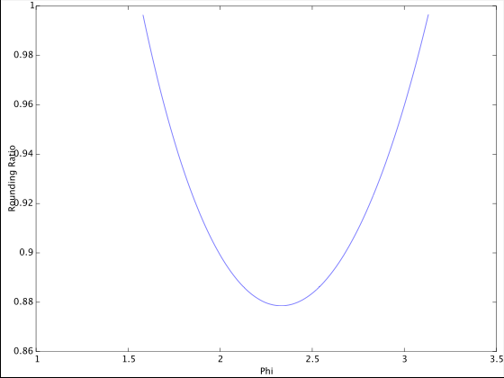
Rounding Ratio
0.87856

Slide 18
Semidefinite Programming

